Slide 1
Sentiment Analysis Techniques
By:
Saeid Parvandeh
November 2017

Slide 2
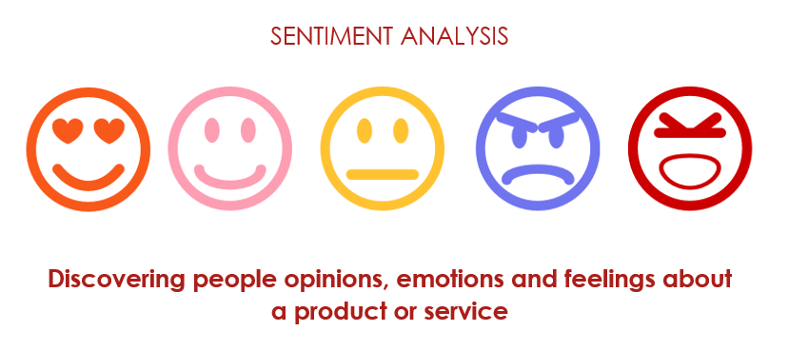
Notes:
A basic task in sentiment analysis is classifying the polarity of a given text at the document, sentence, or feature/aspect level—whether the expressed opinion in a document, a sentence or an entity feature/aspect is positive, negative, or neutral.

Slide 3

Sentiment Lexicon
Notes:
Sentiment lexicon is a set of words (or phrases) each of which is assigned with a sentiment polarity (e.g. -x to x) score.

Slide 4
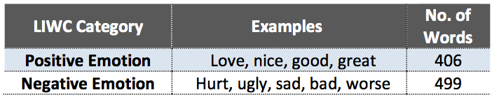
Sentiment lexicons
Semantic orientation (polarity-based) lexicons
LIWC (positive: 406, negative: 499)
GI (positive: 1915, negative: 2291)
Hu-Liu04 (positive: 2006, negative: 4783)
Notes:
LIWC: Linguistic Inquiry and Word Count
GI: General Inquirer
Hu and Liu

Slide 5
Sentiment lexicons
Semantic intensity (valence-based) lexicons
ANEW (1 to 9)
example
Betray 1.68
Bland 4.01
Dream 6.73
Delight 8.26
SentiWordNet (0 to 1)
SentiNet (-1 to 1)
Notes:
ANEW: Affective Norms for English Words

Slide 6
Sentiment lexicons
Lexicons and context-awareness
WSD: refers to the process of identifying which sense of a word is used in a sentence when the word has multiple meanings
example
At first glance the contract looks good, but there’s a catch (negative sentiment)
The fisherman plans to sell his catch at the market (neutral sentiment)
Notes:
WSD: Word Sense disambiguation
Catch: hunt

Slide 7
Machine learning approaches
Naïve Bayes
Maximum Entropy
Support Vector Machines (SVM)
SVM-classification
SVM-regression

Slide 8
VADER
A rule-based sentiment analysis engine
1. works well on social media
2. requires no training data, but is constructed a generalizable, valence-based, human-curated gold standard sentiment lexicon
3. fast enough to be used online
4. does not severely suffer from a speed-performance trade-off
Notes:
2. vader_sentiment_lexicon.txt
Empirically validated by multiple independent human judges, VADER incorporates a "gold-standard" sentiment lexicon that is especially attuned to microblog-like contexts.
The VADER sentiment lexicon is sensitive both the polarity and the intensity of sentiments expressed in social media contexts, and is also generally applicable to sentiment analysis in other domains.
Manually creating (much less, validating) a comprehensive sentiment lexicon is a labor intensive and sometimes error prone process, so it is no wonder that many opinion mining researchers and practitioners rely so heavily on existing lexicons as primary resources. We are pleased to offer ours as a new resource.
We begin by constructing a list inspired by examining existing well-established sentiment word-banks (LIWC, ANEW, and GI). To this, we next incorporate numerous lexical features common to sentiment expression in microblogs, including
- a full list of Western-style emoticons, for example, :-) denotes a smiley face and generally indicates positive sentiment)
- sentiment-related acronyms and initialisms (e.g., LOL and WTF are both examples of sentiment-laden initialisms)
- commonly used slang with sentiment value (e.g., nah, meh and giggly).
This process provided us with over 9,000 lexical feature candidates. Next, we assessed the general applicability of each feature candidate to sentiment expressions. We used a wisdom-of-the-crowd13 (WotC) approach (Surowiecki, 2004) to acquire a valid point estimate for the sentiment valence (intensity) of each context-free candidate feature. We collected intensity ratings on each of our candidate lexical features from ten independent human raters (for a total of 90,000+ ratings). Features were rated on a scale from "[ñ4] Extremely Negative" to "[4] Extremely Positive", with allowance for "[0] Neutral (or Neither, N/A)".
We kept every lexical feature that had a non-zero mean rating, and whose standard deviation was less than 2.5 as determined by the aggregate of ten independent raters. This left us with just over 7,500 lexical features with validated valence scores that indicated both the sentiment polarity (positive/negative), and the sentiment intensity on a scale from -4 to +4. For example, the word "okay" has a positive valence of 0.9, "good" is 1.9, and "great" is 3.1, whereas "horrible" is -2.5, the frowning emoticon :( is -2.2, and "sucks" and it's slang derivative "sux" are both -1.5.

Slide 9
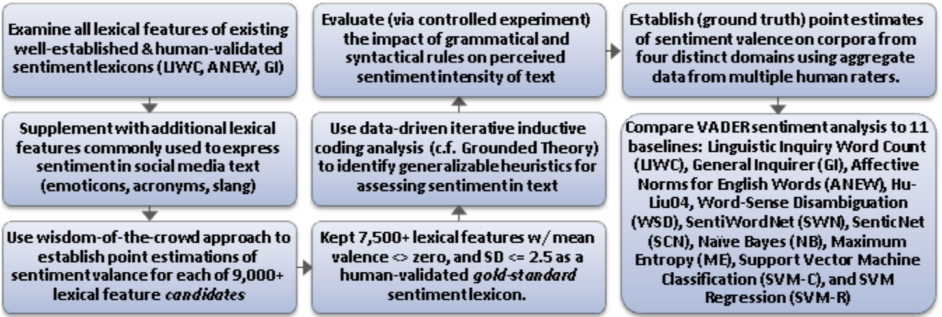
VADER
Notes:
Wisdom of the Crowd approach is used to acquire a valid point estimate for the sentiment valence (intensity) of each context-free candidate feature. Intensity ratings collected on each of candidate lexical features from ten independent human raters (total 90,000+ratings). Rating obtained using Amazon Mechanical Turk (AMT).

Slide 10
VADER is rule-based
1. Punctuation increase the intensity
The food here is good.
The food here is good!!!
2.Capitalization increase the sentiment intensity
The food here is GREAT!
The food here is great!
3. Degree adverbs impact sentiment intensity
The service here is extremely good
The service here is good
4. The contrastive conjunction “but” signals a shift in sentiment polarity
The food here is great, but the service is horrible.
5. Examining the tri-gram preceding a sentiment-laden lexical feature
The food here isn’t really all that great

Slide 11
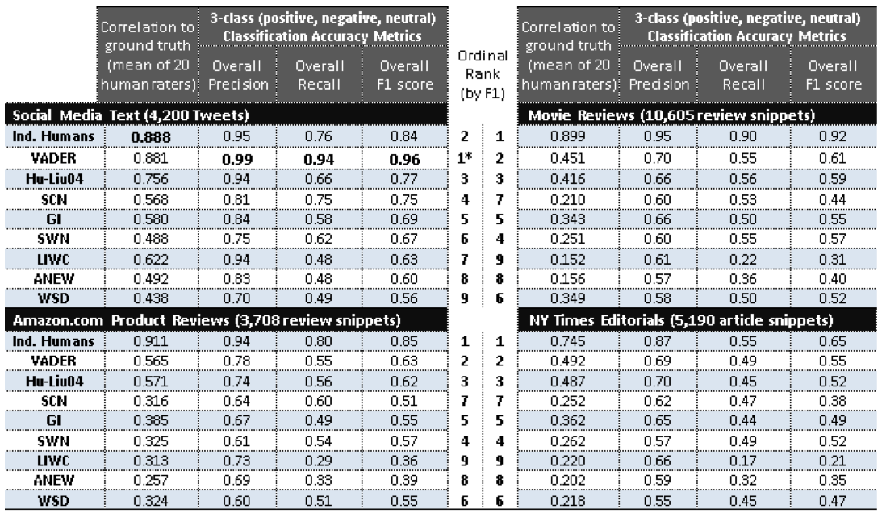

Slide 12
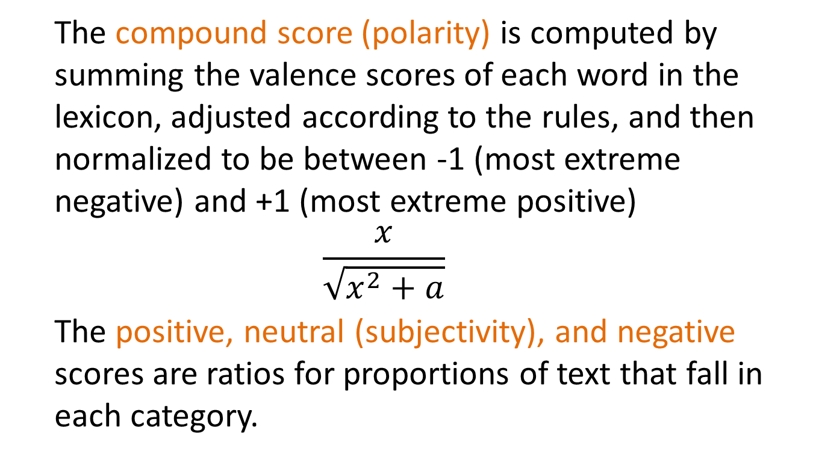
Sentiment Scores
The compound score (polarity) is computed by summing the valence scores of each word in the lexicon, adjusted according to the rules, and then normalized to be between -1 (most extreme negative) and +1 (most extreme positive)
$$\frac{x}{\sqrt{x^{2}+a}}$$
The positive, neutral (subjectivity), and negative scores are ratios for proportions of text that fall in each category.
Notes:
x: sum of sentiment scores of the words
a: a normalization parameter (generally a=15)
It is also useful for researchers who would like to set standardized thresholds for classifying sentences as either positive, neutral, or negative. Typical threshold values (used in the literature cited on this page) are:
positive sentiment: compound score >= 0.5
neutral sentiment: (compound score > -0.5) and (compound score < 0.5)
negative sentiment: compound score <= -0.5
Scoring process: first of all, it reads the sentiment_lexicon using nltk.data.load, and just preserves [words, measure]. Next, it starts to read and tokenize the text using SentiText, we will have a list of words that are in our text that might have a valence. It tries to look up each word of list in sentiment lexicon and retain the valence (measure) of each word. It applies the five rules on the words (punc, upper/lower, bi-grams/tri-gram, but, intensity). In scoring if a word valence is >0 then adds 1 (compensate of neutral), if <0 then adds -1 (compensate of neutral), if ==0 adds 1. Final scores will be sum of all valence scores (either positive, negative, or neutral) dividing by total valence scores (pos+neu+neg) and compound is sum of all words valence scores and normalizing using this equation (x/sqrt(x^2+a)), where x is sum of sentiment score of words, and a is normalization parameter (general a=15). This process applies on each sentence separately.

